Slide 1
HACKORBIT 2K26
Notes Digitizer + Summarizer
TEAM DETAILS
TEAM NAME
TEAM LEADER
TEAM MEMBERS
HACKMINDS
TRACK: NEURAL NEXUS
BABITHA M 7376242AD126 AIDS
MADHUVIDHYA P 7376242AD210 AIDS
TEAM NAME • INSTITUTION
1

Slide 2
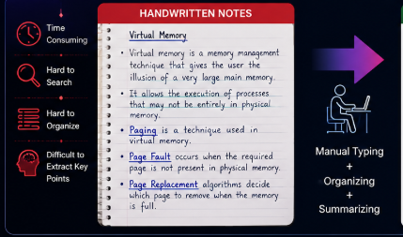
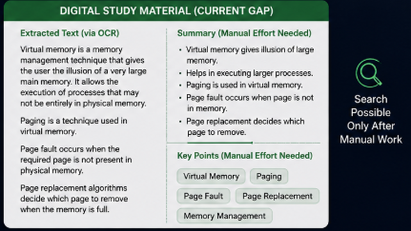
HACKORBIT 2K26
PROBLEM STATEMENT
Define the problem clearly and concisely
THE PROBLEM
VISUAL / EVIDENCE
Problem Statement:
Handwritten academic notes are difficult to digitize, organize and revise efficiently. Students often need to manually convert their notes into digital text and then spend additional time identifying important information and creating concise study material.
• What is the existing problem? Handwritten notes are difficult to search, edit and quickly understand. • Who is affected? Students and learners who depend on handwritten academic notes. • Why is it important? Manual digitization and revision take additional time and effort, especially when preparing from lengthy notes. • What are the limitations of current solutions? Existing OCR-focused solutions mainly convert handwriting into text. They do not provide a complete workflow for turning the extracted content into concise, revision-ready study material.
TEAM NAME • INSTITUTION
3

Slide 3
HACKORBIT 2K26
PROPOSED SOLUTION
Explain your idea in one clear flow
01 PROBLEM
02 SOLUTION
03 TECHNOLOGY
04 OUTCOME
Handwritten notes are difficult to digitize, understand and revise efficiently.
NoteWise AI
Upload or capture handwritten notes and automatically convert them into structured, concise and revision-ready study material.
Image Processing + OCR + NLP + AI
Flow:
Handwritten Image → Preprocessing → OCR → Text Cleaning → AI Summarization → Key Concepts
A single handwritten page becomes searchable digital content with a concise summary and revision-ready learning material.
NoteWise AI digitizes handwritten notes using OCR and processes the extracted content using AI/NLP. It generates a concise summary and identifies important concepts, creating a faster path from handwritten notes to useful study material.
TEAM NAME • INSTITUTION
4

Slide 4
HACKORBIT 2K26
INNOVATION & USP
What makes your solution different?
AI / ML
REAL-TIME
COST EFFECTIVE
Combines handwriting OCR with NLP-based content understanding to transform raw handwritten notes into meaningful study material.
Processes an uploaded note and produces digitized content and a summary within a short interaction flow. .
Designed using lightweight, accessible AI/ML components without requiring specialized hardware.
SCALABLE
USER FRIENDLY
Can expand from individual notes to multiple subjects, notebooks, languages and institutional learning resources.
One simple workflow: Upload → Digitize → Summarize → Revise.
TEAM NAME • INSTITUTION
5

Slide 5
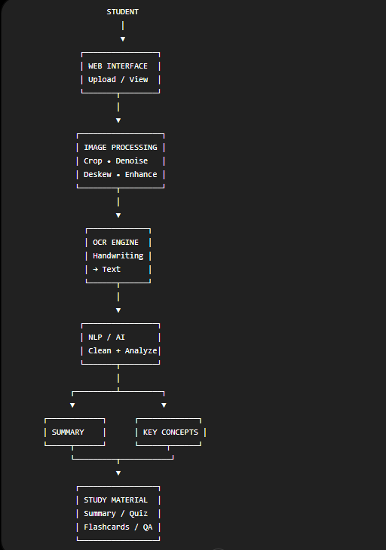
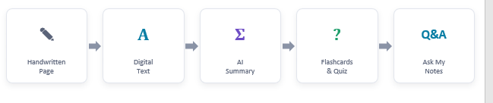
HACKORBIT 2K26
SYSTEM ARCHITECTURE
Replace the placeholders with your architecture diagram
USER
FRONTEND
BACKEND
DATABASE
Student
Upload + Dashboard
OCR/NLP processing API
Notes + extracted text + results
AI / ML
APIs
OCR + NLP + summarization + semantic retrieval
Only include external services that you actually use.
USER → FRONTEND → BACKEND → AI/ML → OUTPUT
6

Slide 6
HACKORBIT 2K26
TECHNOLOGY STACK
Show only technologies actually used
FRONTEND
BACKEND
DATABASE
HTML • CSS • JavaScript
Note upload interface
Results dashboard
Summary & Q&A display
Python • Flask
Handles uploads
Connects frontend with AI pipeline
Processes results
SQLite
Notes
Extracted text
Summaries
User results
AI / ML
DEPLOYMENT
OCR • OpenCV • NLP
Image preprocessing
Handwriting recognition
Text cleaning
Summarization
Key concept extraction
Internal REST API
Frontend ↔ Backend communication
DEPLOYMENT
GitHub
For source-code management and project sharing.
7

Slide 7
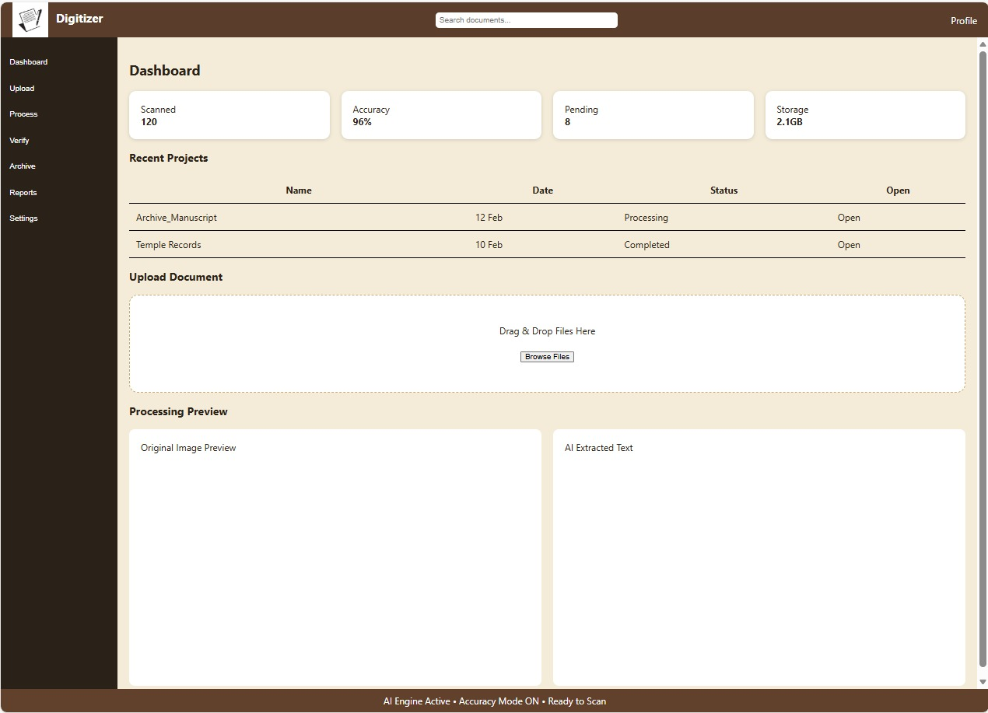
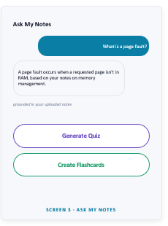
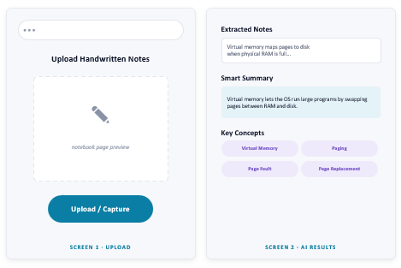
HACKORBIT 2K26
PROTOTYPE / WORKING MODEL / IMPLEMENTATION PLAN
Insert screenshots of the actual implementation
SCREEN 01
SCREEN 02
SCREEN 03
[Insert screenshot here]
Workflow description
Upload a handwritten page → extract and clean the text → generate a concise summary and key concepts → create revision-ready learning content.
8

Slide 8
HACKORBIT 2K26
IMPACT & BENEFITS
Quantify the expected value wherever possible
XX%
4+ OUTPUTS
On-demand access
24/7
Handwritten input
-Time saved
Text • Summary • Key Concepts • Revision
-Cost reduced
Target users
Availability
SOCIAL IMPACT
ECONOMIC IMPACT
SCALABILITY
Makes handwritten academic knowledge easier to access, search and revise.
Reduces repetitive manual effort involved in typing and organizing handwritten study material.
Can expand to multiple subjects, regional-language handwriting, mobile capture and institutional learning platforms.
9

Slide 9
HACKORBIT 2K26
FUTURE SCOPE & CONCLUSION
End with a clear vision
FUTURE SCOPE
CONCLUSION
• Multilingual Handwriting
Support Indian regional-language handwriting.
• Voice Interaction
Ask questions and listen to explanations.
• Mobile Application
Capture handwritten notes directly using a smartphone camera.
• Cross-Document Knowledge
Search and connect information across multiple notebooks.
• Personalized Learning
Adapt summaries, quizzes and revision material to the learner.
NoteWise AI transforms handwritten academic notes into structured digital learning material. By combining OCR, image processing and AI-based text understanding, it reduces the effort required to digitize and summarize notes. The solution creates a simple path from handwritten content to faster revision and learning. OUR VISION
“Every handwritten note should become searchable knowledge.”
“We don't just digitize notes. We make them useful.”
THANK YOU
10

